Slide 1
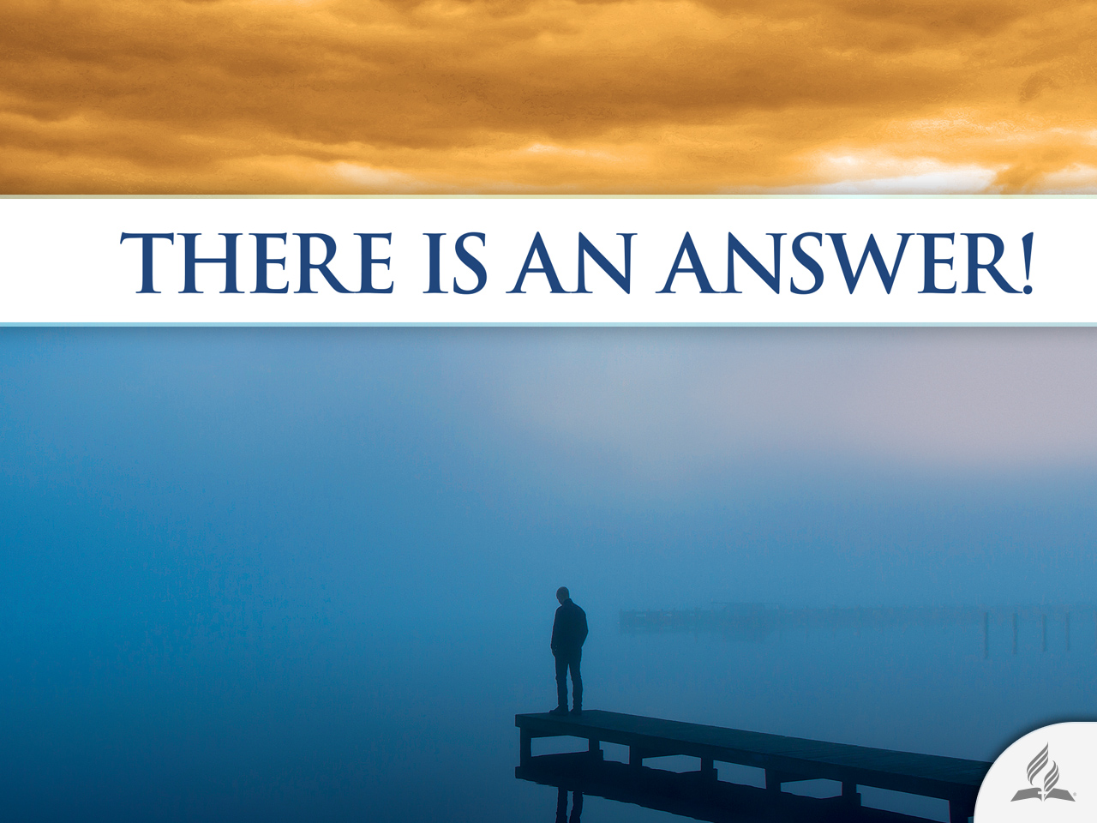

Slide 2




Why Pain, Suffering, and Death?
Topic 4

Slide 3
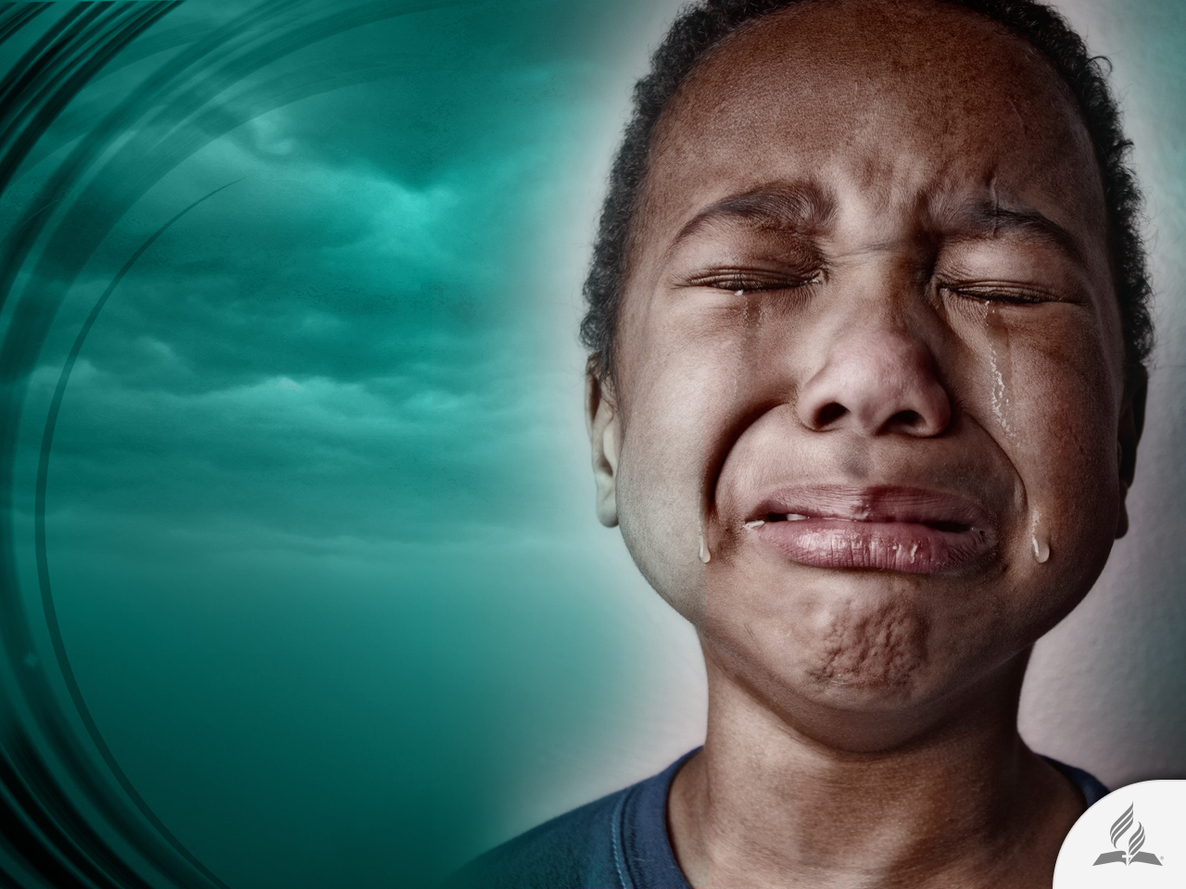
The Mystery of Pain
If God created a perfect world, why do pain, suffering, and death exist?
Pain is a mystery.

Slide 4
Back to Genesis
The biblical account of Creation says: “God saw all that he had made, and it was very good” (Gen. 1:31).
What happened to this world that made it “very good?” Where did evil originate?
The Bible says that evil is sin. It does not explain its origin; it merely narrates how it surfaced. The writers of the Old Testament do not bother to explain evil in detail. To them, evil is an undeniable reality, sin an obvious fact. The important thing is to know how to cope with it.
Evil has no explanation. If we could explain it, we could justify it.

Slide 5
A Perfect Angel
“You were anointed as a guardian cherub, for so I ordained you. You were on the holy mount of God; you walked among the fiery stones. You were blameless in your ways from the day you were created till wickedness was found in you. Through your widespread trade you were filled with violence, and you sinned. So I drove you in disgrace from the mount of God, and I expelled you, guardian cherub, from among the fiery stones. Your heart became proud on account of your beauty, and you corrupted your wisdom because of your splendor. So I threw you to the earth; I made a spectacle of you before kings” (Ezek. 28:14-17).

Slide 6
The Risk of Freedom
God did not create the devil; He created a perfect angel.
But why did a perfect angel choose evil? And if he did, does it mean that evil already existed? No. The possibility of evil existed, but not evil.
The perfection of Lucifer required freedom; a slave could not be perfect.
In order to be free, Lucifer had to choose in such a way that the ability to choose required the possibility to follow the path of good or of evil. Otherwise, how could he be free?
However, the possibility of a situation does not necessarily mean it has to occur.

Slide 7
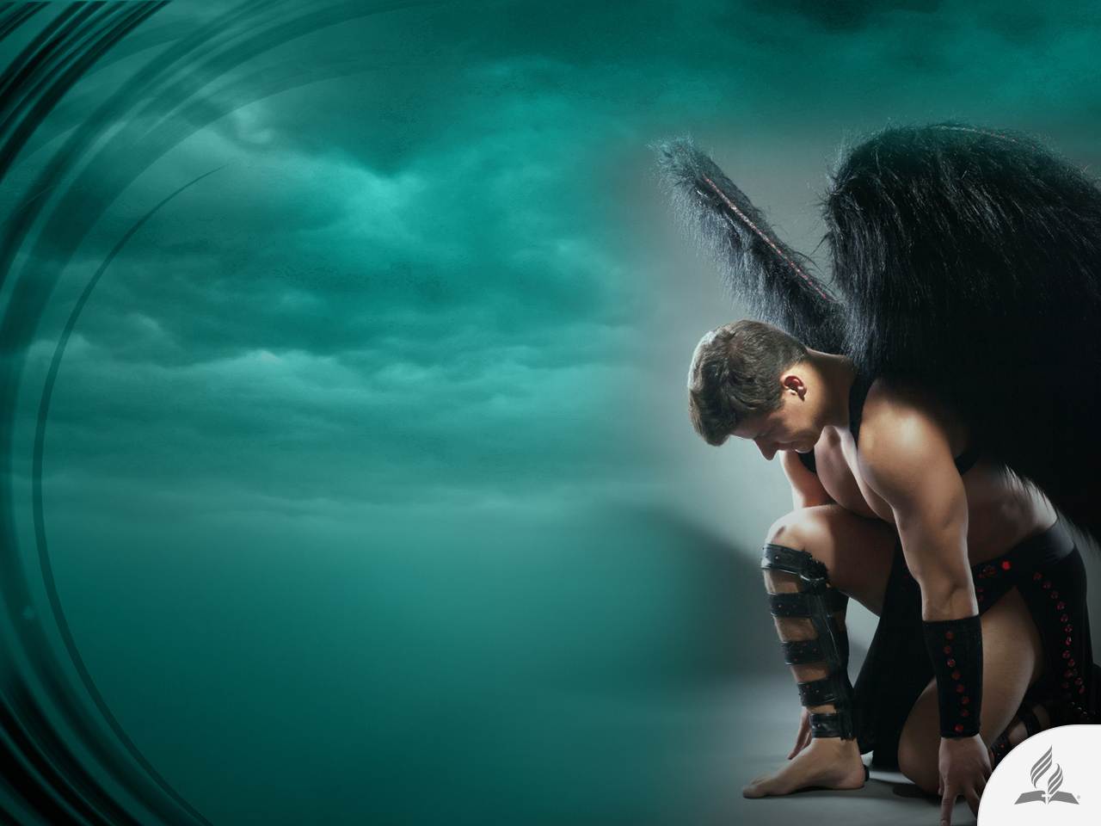
Rebellion in Heaven
“Then war broke out in heaven. Michael and his angels fought against the dragon, and the dragon and his angels fought back.
But he was not strong enough, and they lost their place in heaven.
The great dragon was hurled down—that ancient serpent called the devil, or Satan, who leads the whole world astray. He was hurled to the earth, and his angels with him” (Rev. 12:7-9).

Slide 8

Lucifer Is Moved to Earth
The Lord warned Adam and Eve about the presence of an enemy.
“You are free to eat from any tree in the garden; but you must not eat from the tree of the knowledge of good and evil, for when you eat from it you will certainly die” (Gen. 2:16, 17).

Slide 9
Sin Enters in Earth
“Now the serpent was more crafty than any of the wild animals the Lord God had made. He said to the woman, ‘Did God really say, “You must not eat from any tree in the garden”?’ The woman said to the serpent, ‘We may eat fruit from the trees in the garden, but God did say, “You must not eat fruit from the tree that is in the middle of the garden, and you must not touch it, or you will die.”’ ‘You will not certainly die,’ the serpent said to the woman. ‘For God knows that when you eat from it your eyes will be opened, and you will be like God, knowing good and evil.’ When the woman saw that the fruit of the tree was good for food and pleasing to the eye, and also desirable for gaining wisdom, she took some and ate it. She also gave some to her husband, who was with her, and he ate it” (Gen. 3:1-6).

Slide 10

SOME EFFECTS OF SIN

Slide 11
Adam and Eve
Loss of innocence. Fear, shame, and guilt. Inability to enjoy face to face fellowship with God (Gen. 3:8-10).
Innocent bloodshed (Gen. 3:21).
Criticism and demands in the first couple.
Family harmony broken (Gen. 3:12).
Work becomes a burden (Gen. 3:19).
Childbirth becomes a source of pain, and we see the rise of the mistreatment of women (Gen. 3:16).

Slide 12
The Human Race
Sin entered the entire world (Rom. 5:12-19).
Lack of peace of mind (Is. 57:20-21).
Bound to the constant habit of sinning (John 8:34).
Physical death (Gen. 2:17; 1 Cor. 15:56).
Lack of will to live (Eph. 2:1).

Slide 13
The Human Race
Filth (Is. 64:6; Ps. 106:39).
Guilt (Ezra 9:6; Gen. 3:10).
Separation from God (Is. 1:15; 59:2).
Poisoning of human relationships (Deut. 15:7-8; 25:13-15).

Slide 14
The Nature
Earth tarnished (Gen. 3:17, 18; Jer. 12:13; Rom. 8:20-22).
Pollution of the planet (Lev. 18:25; Gen. 4:10-12; Num. 35:33, 34).

Slide 15

GOOD AND BAD SEEDS
Living in a world injured by sin

Slide 16
Matthew 13:24-30
“The kingdom of heaven is like a man who sowed good seed in his field. But while everyone was sleeping, his enemy came and sowed weeds among the wheat, and went away. When the wheat sprouted and formed heads, then the weeds also appeared.
The owner’s servants came to him and said, ‘Sir, didn’t you sow good seed in your field? Where then did the weeds come from?’
‘An enemy did this,’ he replied.
The servants asked him, ‘Do you want us to go and pull them up?’
‘No,’ he answered, ‘because while you are pulling the weeds, you may uproot the wheat with them. Let both grow together until the harvest. At that time I will tell the harvesters: First collect the weeds and tie them in bundles to be burned; then gather the wheat and bring it into my barn.’”

Slide 17

God Did Not Seed Sin in This World
Satan introduced sin on the Earth. He accused the Lord of being responsible for the bad seed.

Slide 18

A World with Good and Bad Seeds
In this world we have good and bad people.
This will not change until the Lord comes in His glory.

Slide 19
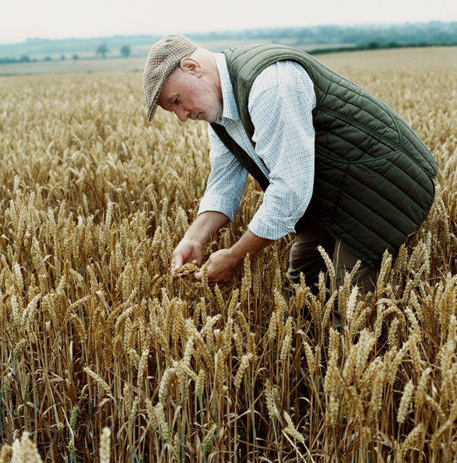
WHEAT TARES
Wheat and tares look very similar, and it takes an experienced eye to discern between them.

Slide 20

Only God Can Judge
It is not our work to decide which ones are the good and which ones are the bad. He is the Only one who can do the work of separation.

Slide 21
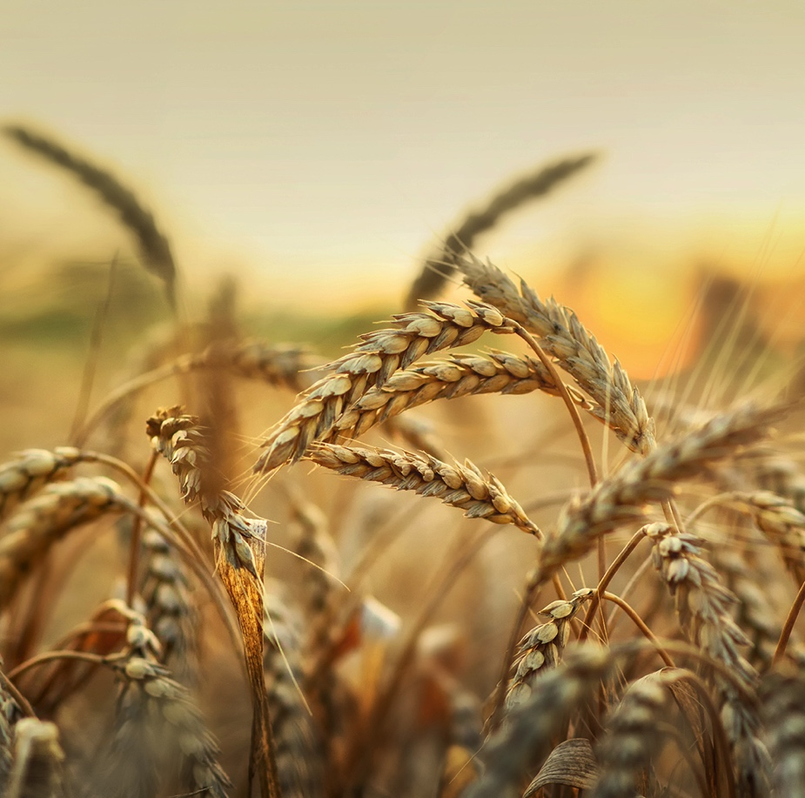
We Must Wait
Good and bad seeds must grow together in order to not injure the wheat. Weeds must show their “real character,” then they will be uprooted.

Slide 22
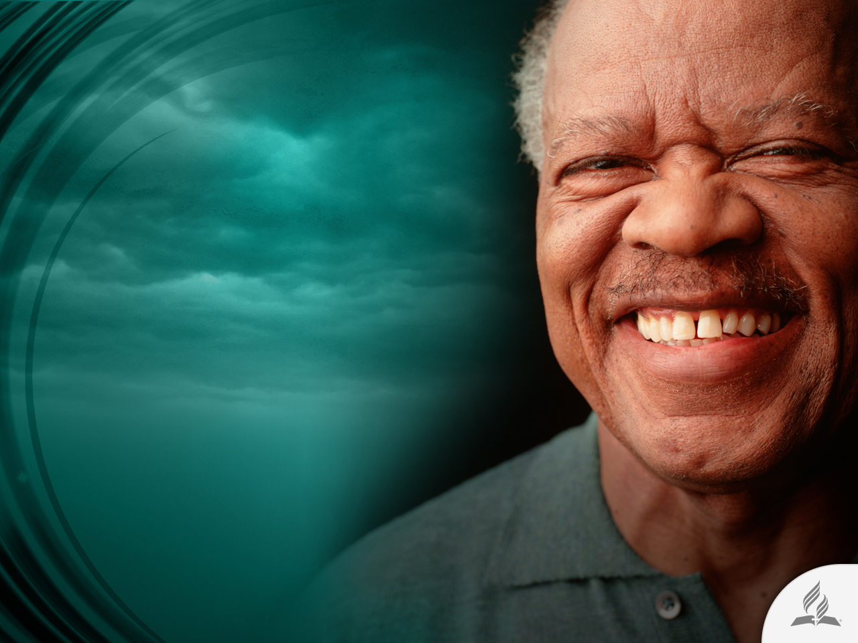
Evil Does Not Prevail
“He will wipe every tear from their eyes. There will be no more death or mourning or crying or pain, for the old order of things has passed away” (Rev. 21:4).

Slide 23

MORE THAN CONQUERORS

Slide 24
A Great Truth
“Who shall separate us from the love of Christ? Shall trouble or hardship or persecution or famine or nakedness or danger or sword? As it is written: ‘For your sake we face death all day long; we are considered as sheep to be slaughtered.’ No, in all these things we are more than conquerors through him who loved us. For I am convinced that neither death nor life, neither angels nor demons, neither the present nor the future, nor any powers, neither height nor depth, nor anything else in all creation, will be able to separate us from the love of God that is in Christ Jesus our Lord” (Rom. 8:35-39).

Slide 25
Nothing Can Separate Us from Jesus
Suffering can not separate us from God.
Pain does not need to separate us from God.
The Bible says: “God is our refuge and strength, an ever-present help in trouble. Therefore we will not fear, though the earth give way and the mountains fall into the heart of the sea, though its waters roar and foam and the mountains quake with their surging” (Ps. 46:1-3).

Slide 26

The Power of God’s Love
“The Lord appeared to us in the past, saying: ‘I have loved you with an everlasting love; I have drawn you with unfailing kindness’” (Jeremiah 31:3).

Slide 27
Summary
God did not create the devil; He created a perfect angel.
The perfection of Lucifer required freedom; a slave could not be perfect. Sadly, he rebelled against the Lord.
The Lord warned Adam and Eve about the presence of an enemy, but they were deceived anyway.
Effects of the sin were evident in Adam and Eve, human beings and nature.
Suffering and pain are consequences of the sin that Satan introduced in this world.
However, neither sin, nor suffering and pain can separate us from Jesus. He helps us to be more than conquerors.

Slide 28
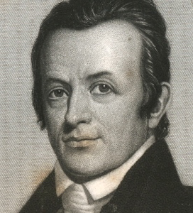
The Love of a Missionary
Adoniram Judson, the renowned missionary to Burma, endured untold hardships trying to reach the lost for Christ.
For seven heartbreaking years he suffered hunger and privation. During this time he was thrown into Ava Prison, and for 17 months was subjected to almost incredible mistreatment.
As a result, for the rest of his life he carried the ugly marks made by the chains and iron shackles that had cruelly bound him.

Slide 29
The Love of a Missionary
Undaunted, upon his release he asked for permission to enter another province where he might resume preaching the Gospel.
The godless ruler indignantly denied his request, saying, “My people are not fools enough to listen to anything a missionary might SAY, but I fear they might be impressed by your SCARS and turn to your religion!”

Slide 30
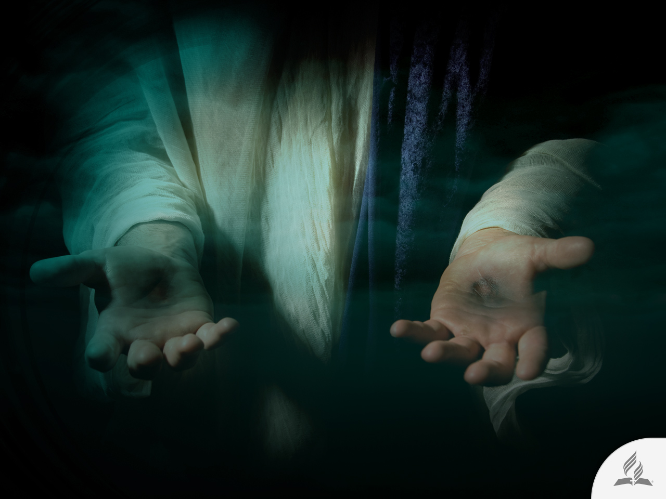
My Decision
The Bible says: “Come to me, all you who are weary and burdened, and I will give you rest. Take my yoke upon you and learn from me, for I am gentle and humble in heart, and you will find rest for your souls. For my yoke is easy and my burden is light” (Matt. 11:28-30).
Are you willing to go to Jesus in order to receive rest for your soul?

Slide 31
Next Topic:
CAN GOD CHANGE MY LIFE?
A Tendency toward Evil.
Separated from God.
The Only Solution.
Three Attitudes toward Jesus.
The Final Moment of His Life.

